Slide 1



Sentinel
GRC
AI-assisted platform for technology configuration & compliance assessment
By Pranjal Ambwani

Slide 2



Table Of Contents
SOLUTION & PROBLEM
ARCHITECTURE
VALIDATION
Purpose, scope & objectives.
Prototype design & enterprise evolution
.
Core test scenarios
.

Slide 3


1
SOLUTION& PROBLEM

Slide 4
Why This Is Hard Today
Manual and fragmented technology compliance assessments make it difficult to manage checklists, track assessment progress, record findings consistently, monitor overall results, and prepare reports.
Duplicated Checklists
Inconsistent Findings
No Single View
Slow Manual Reporting
Checklists are duplicated across files and can go out of date without anyone noticing.
Findings are recorded inconsistently between reviewers, since there is no shared format or single source of truth.
There is no single place to see overall compliance status at a glance, delaying identification of non-compliant configurations.
Preparing a final report means manually gathering information from scattered sources — slow and prone to error.

Slide 5
Solution Design Overview — Purpose & Objectives
Purpose
Objectives
Deliver a working single-user prototype that demonstrates the full compliance assessment workflow, from checklist selection to report generation.
Demonstrate a practical, human-supervised use of AI: generating draft checklists for new technologies, always subject to human review.
Provide a compliance dashboard that gives a clear, consolidated view of assessment status.
Establish a layered architecture that can realistically scale into an enterprise-ready platform without a full redesign
This document outlines the functional solution design for Sentinel GRC, an AI-assisted platform for managing technology configuration and compliance assessments. It is developed as an academic M.Tech project, providing a clear roadmap of what has been built as a working prototype, how it functions, and how it could evolve into an enterprise-grade platform.

Slide 6
A deliberate prototype boundary
Engagement Management — Create & manage technology assessments
Checklist Management — Load existing or AI-generate draft checklists
Human-in-the-Loop — Review, edit, approve/reject AI-generated checklists
Control Assessment — Capture compliance status, evidence & comments
Dashboard & Reporting — Track progress and generate assessment reports
Production Deployment — CI/CD, containers & cloud
Multi-User Workflows — Access & approvals
Enterprise Data Layer — Cloud DB & multi-agent AI
Enterprise Integrations — Onboarding & external systems
Security Monitoring — Real-time monitoring & pentesting
SIEM Integration — SIEM & audit platforms
Proprietary AI Model — Foundation model development
CURRENT PROTOTYPE
Future Enhancements

Slide 7

2
ARCHITECTURE

Slide 8
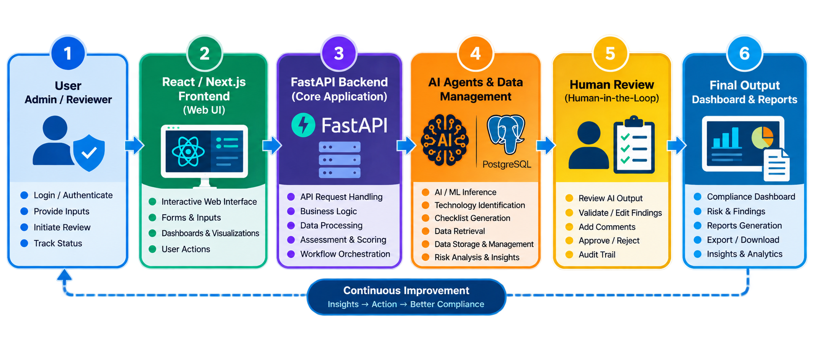

Slide 9






Architecture Components
1
2
3
User Interface
Core Application (Python)
AI Module
Interactive web interface: pages, forms, tables, charts, and input fields to navigate engagements and checklists.
Main application logic covering engagement, checklist, assessment, status, evidence/comments, dashboard, and reports.
Generates a draft checklist for a technology not already in the library, using a pre-trained LLM (e.g., Qwen via Hugging Face). Output is always a draft.
4
5
6
Data Management Module
Human Review (Human-in-the-Loop)
Output Layer
Stores and retrieves the checklist library, assessment data, and engagement data — currently implemented using CSV files.
A human reviewer checks and edits AI-generated checklists, then approves or rejects them before finalisation.
Presents the compliance dashboard (charts and KPIs), assessment results, and generates the final checklists report in DOCX/exportable format.

Slide 10
Data Flow
User authentication Sentinel GRC through the web interface and creates a new engagement.
The generate checklists is routed to reviewer for validation, modification and approval or rejection.
1
6
User selects the target platform/technology to be assessed.
The reviewer evaluates the assessment notes, compliance status, evidence, and comments.
2
7
The FastAPI backend queries the checklist repository to determine whether an applicable assessment checklist already exists.
Assessment results and supporting evidence are persisted in the data layer and associated with corresponding engagement.
3
8
If a checklist is available, the backend retrieves the relevant controls from checklists repository.
The backend processes assessment data to calculate identify control gaps, generate risk insights and compliance score for the dashboard.
4
9
If no applicable checklist exists, the AI Module generates a draft checklist using the pre-trained language model.
The system generates a consolidated assessment report containing compliance results, findings, risk information and supporting evidence, with export functionality.
5
10

Slide 11
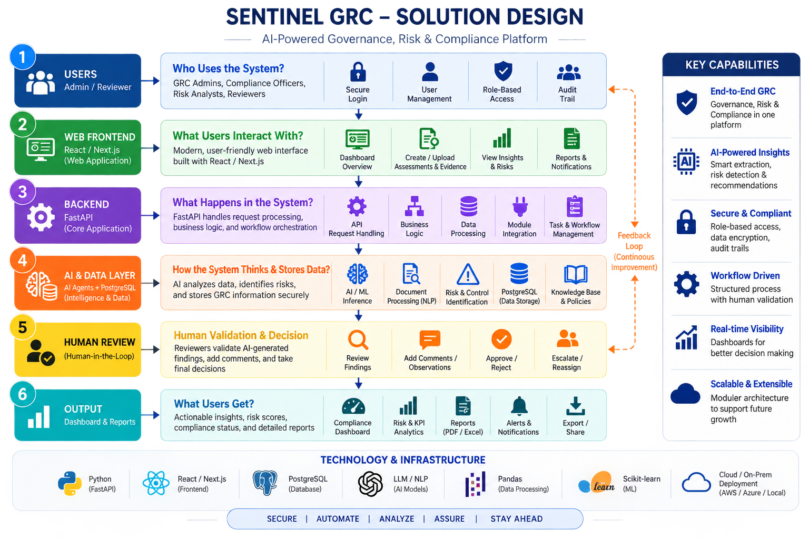

Slide 12





Why This Architecture?
Separation of Concerns
Appropriate Simplicity
Human-in-the-Loop by Design
Frontend, core logic, AI generation, data storage, human review, and output generation are each handled by a distinct part of the system.
CSV storage and a single-user model keep the current implementation lightweight and fast to develop for the prototype stage.
A mandatory human review step ensures AI-generated content is never used directly — essential for a compliance-related tool.
Modularity
Clear, Traceable Data Flow
A Realistic Foundation for Growth
The AI module and Data Management module are separate, focused components that can each be improved or replaced independently.
The sequence of steps makes it straightforward to see how a request moves through the system, supporting development and future auditing.
Cleanly separated responsibilities let the architecture extend later — e.g., CSV to database, single- to multi-user — without a full redesign.

Slide 13
3
VALIDATION

Slide 14
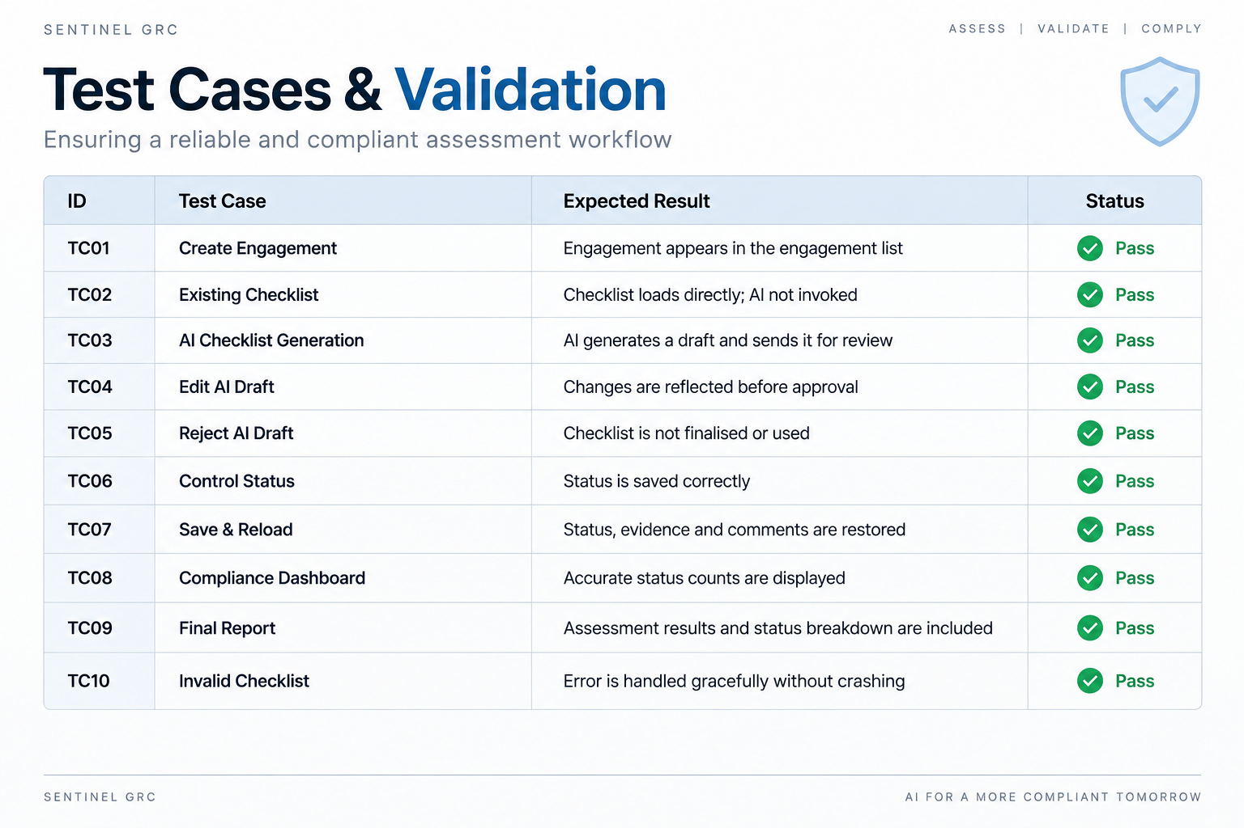

Slide 15


